Slide 1
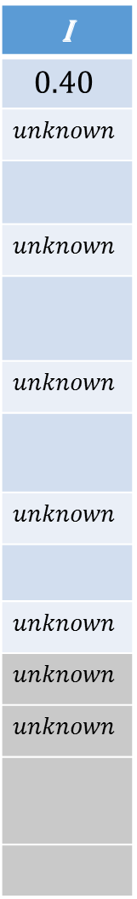
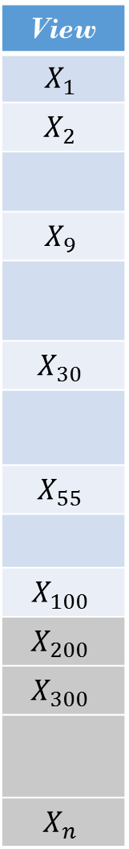




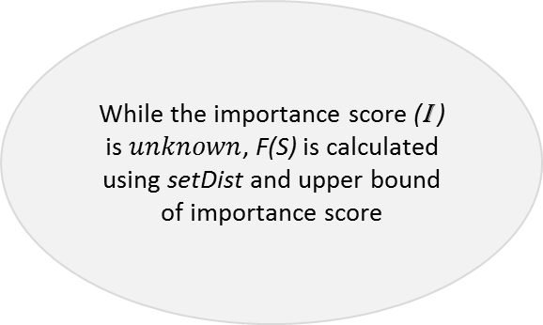
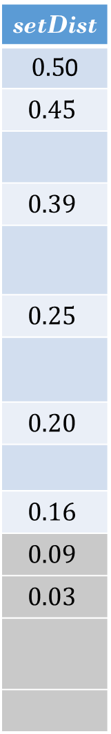
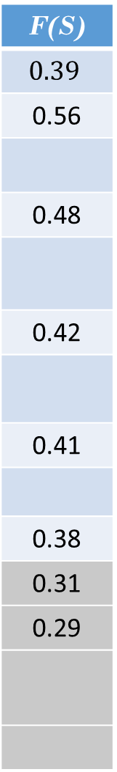
View
$$X_{1}$$
$$X_{2}$$
$$X_{9}$$
$$X_{30}$$
$$X_{55}$$
$$X_{100}$$
$$X_{200}$$
$$X_{300}$$
$$X_{n}$$
setDist
$0.5$0
$$0.45$$
$$0.39$$
$$0.25$$
$$0.20$$
$$0.16$$
$$0.09$$
$$0.03$$
I
$$0.40$$
$$unknown$$
$$unknown$$
$$unknown$$
$$unknown$$
$$unknown$$
$$unknown$$
$$unknown$$
F(S)
$$0.39$$
0.56
0.48
0.42
0.41
0.38
0.31
0.29
$$S_{1}$$
While the importance score (I ) is $unknown$, F(S) is calculated using setDist and upper bound of importance score
$$S_{2}$$
$$set S$$
Pruned
views
$$X$$

